Slide 1

Student Management System
B.Tech Electronics & Communication Engineering
Semester 5 2023-24
Course: DBMS
By
Ishan Nilawar, Div C ,Roll no 18, Batch C3, PRN 1032222650
Ankur Bhat, Div C, Roll no 7, Batch C3, PRN 1032212866

Slide 2
Outline
1.INTRODUCTION 1.1OBJECTIVES 1.2LIMITATIONS 2.STUDY OF EXISTING SYSTEM 2.1ACASESTUDYON 2.2PROPOSEDSYSTEM 2. DATABASE DESIGN 3.1SOFTWAREREQUIREMENTSPECIFICATION 3.1.1COLLECTIONOFREQUIREMENTS 3.1.2SOFTWAREANDHARDWAREREQUIREMENTS 3.2CONCEPTUALDESIGN 3.2.1ERDIAGRAM 3.2.3SCHEMADIAGRAM 3.3IMPLEMENTATION 3.3.1FRONTEND 3.3.2BACKEND 3.3.3TRIGGER 3.3.4STOREDPROCEDURE 3. USER INTERFACES 4.1SCREENSHOTS CONCLUSIONS FUTURE ENHANCEMENTS AND REFERENCES

Slide 3
Student Database Management
Objectives:
The main objective of the project is to design and develop a user friendly-system • Easy to use and an efficient computerized system. • To develop an accurate and flexible system, it will eliminate data redundancy. • To study the functioning of Students management System. • To make a software fast in processing, with good user interface. • To make software with good user interface so that user can change it and it should be used for a long time without error and maintenance. • To provide synchronized and centralized farmer and seller database. • Computerization can be helpful as a means of saving time and money. • To provide better Graphical User Interface (GUI). • Less chances of information leakage. • Provides Security to the data by using login and password method. • To provide immediate storage and retrieval of data and information. • Improving arrangements for students coordination. • Reducing paperwork.

Slide 4
Requirements
Frontend- HTML, CSS, Java Script, Bootstrap Backend-Python flask (Python 3.7) , SQLAlchemy, • Operating System: Windows 10 • Google Chrome/Internet Explorer • XAMPP (Version-3.7) • Python main editor (user interface): PyCharm Community • workspace editor: Sublime text 3

Slide 5
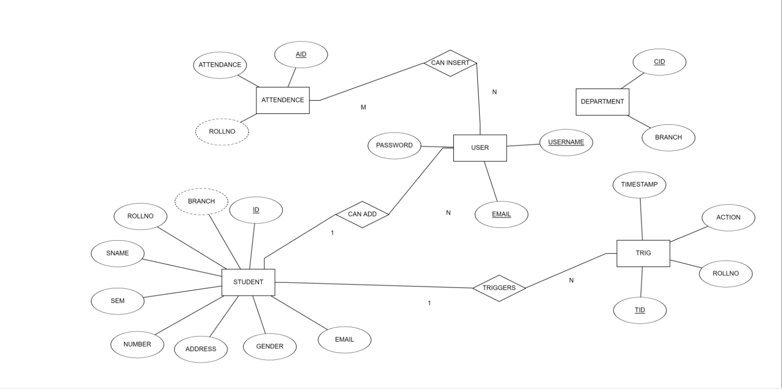
ER Diagram

Slide 6
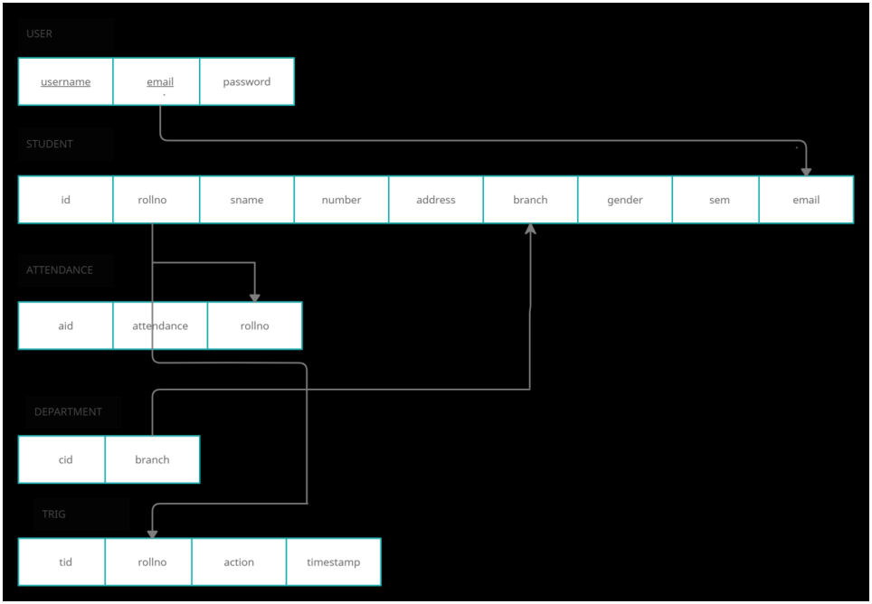
Schema Diagram

Slide 7

Screenshots

Slide 8
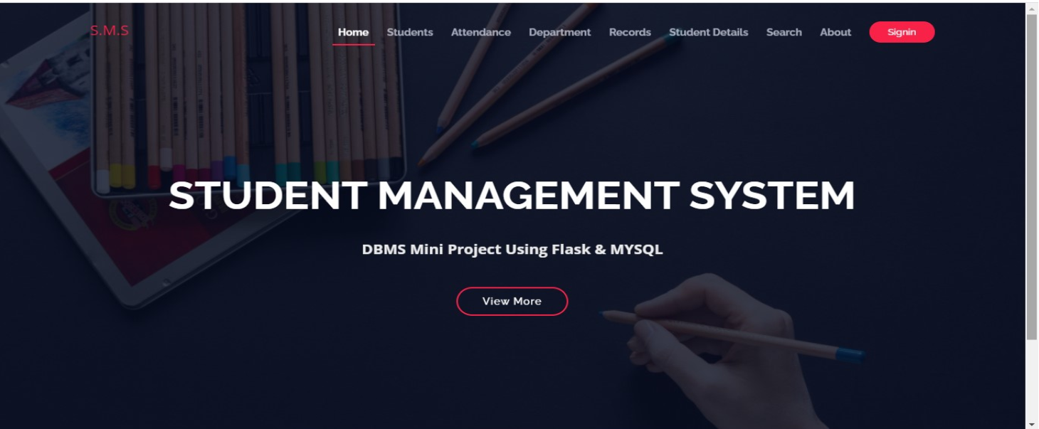

Slide 9
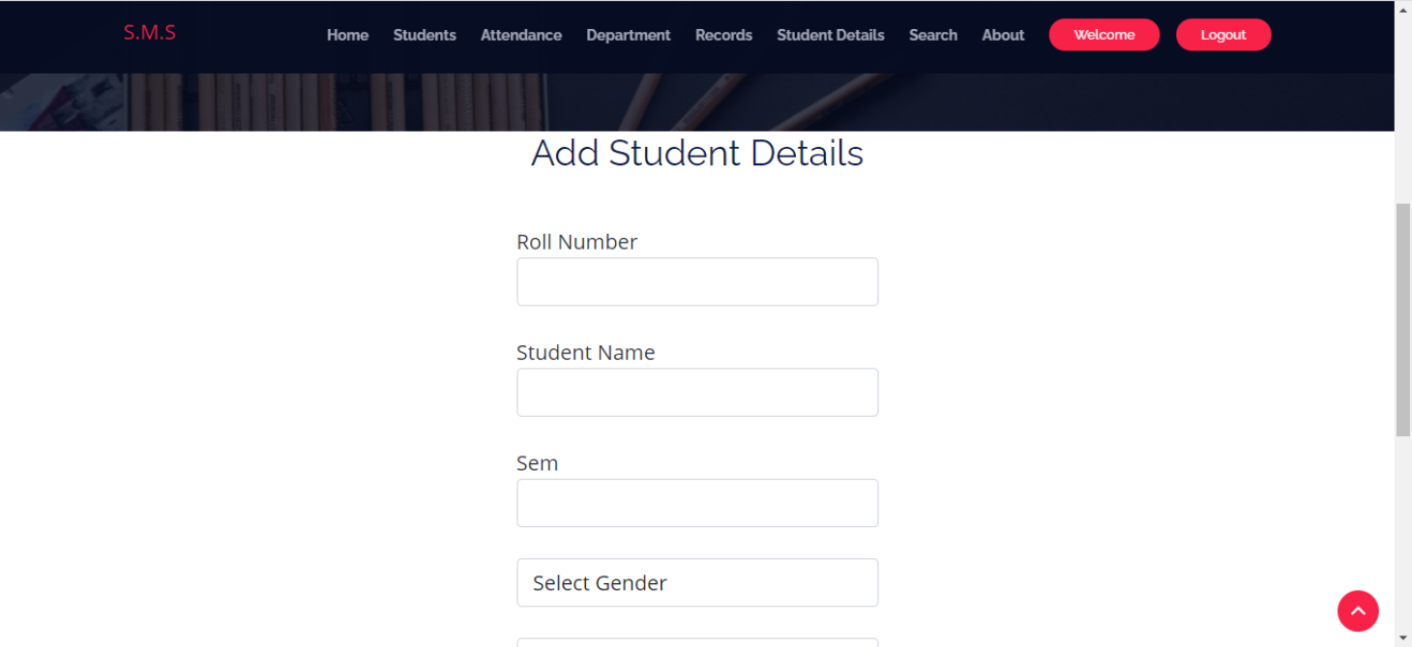

Slide 10
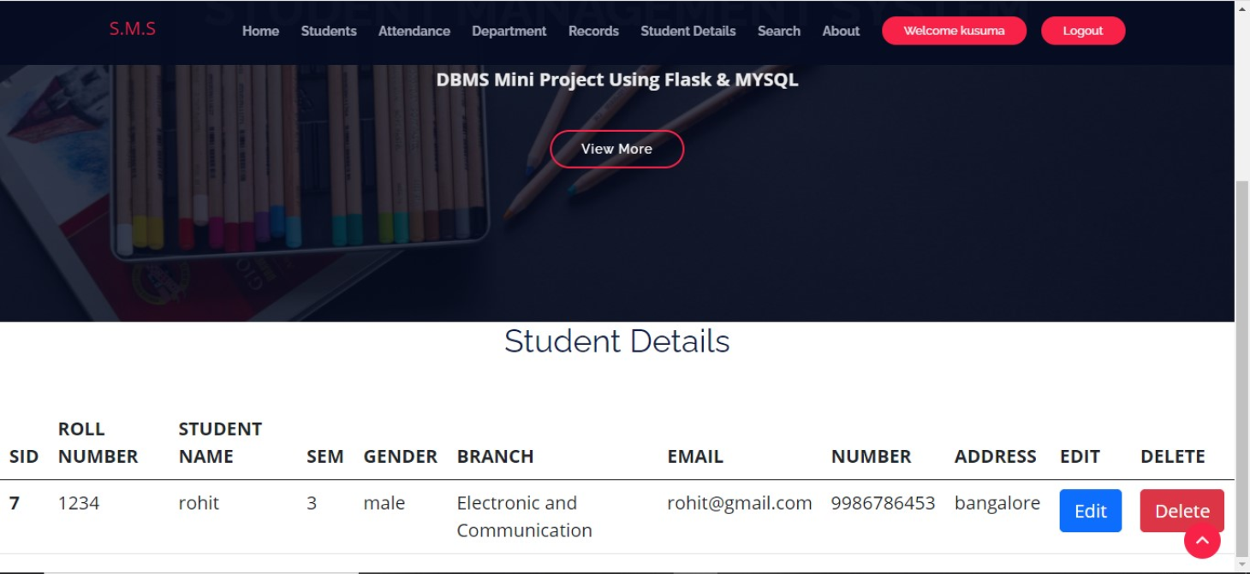

Slide 11
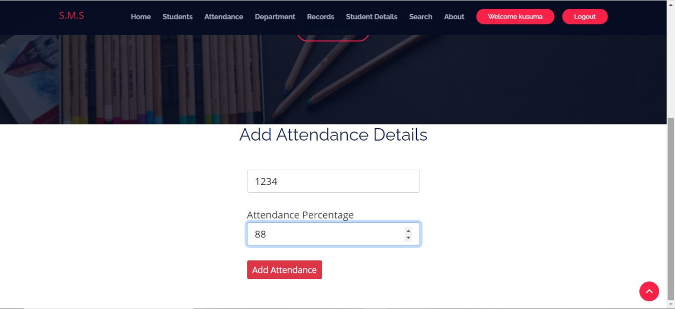

Slide 12
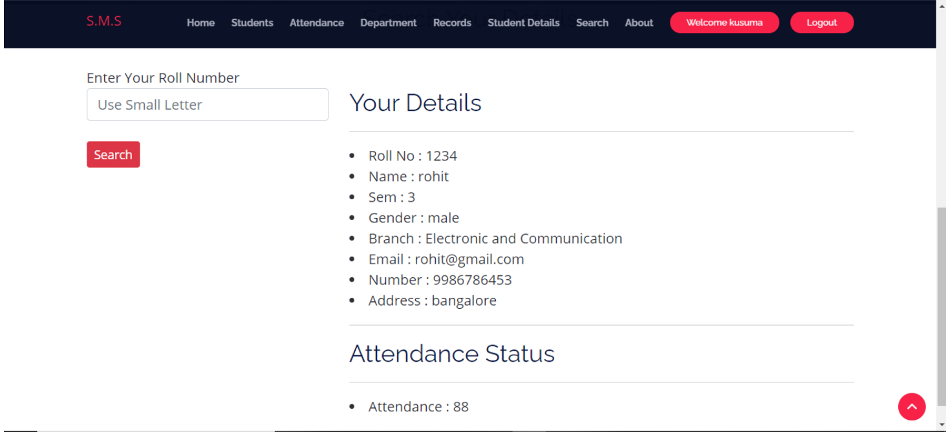

Slide 13
Conclusion
STUDENT MANAGEMENT SYSTEM successfully implemented based on online data filling which helps us in administrating the data user for managing the tasks performed in students. The project successfully used various functionalities of Xampp and python flask and also create the fully functional database management system for online portals. Using MySQL as the database is highly beneficial as it is free to download, popular and can be easily customized. The data stored in the MySQL database can easily be retrieved and manipulated according to the requirements with basic knowledge of SQL.

